Slide 1


Smart
FLOWER
SHOP
UNDER SUPERVISION
Prof. Khaled Wassif
Eng. Ahmed Hany

Slide 2

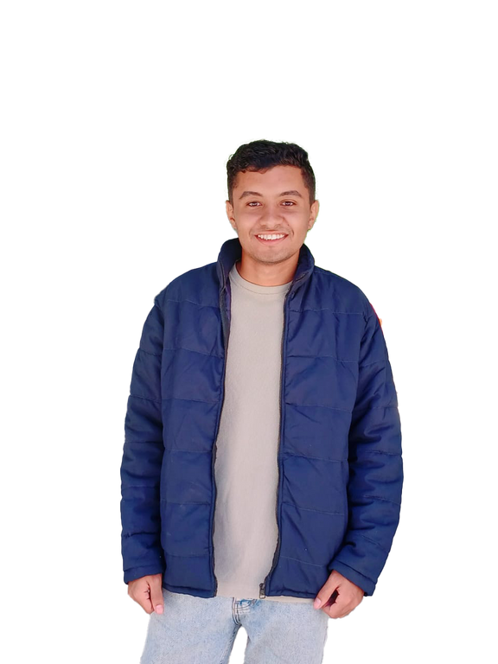


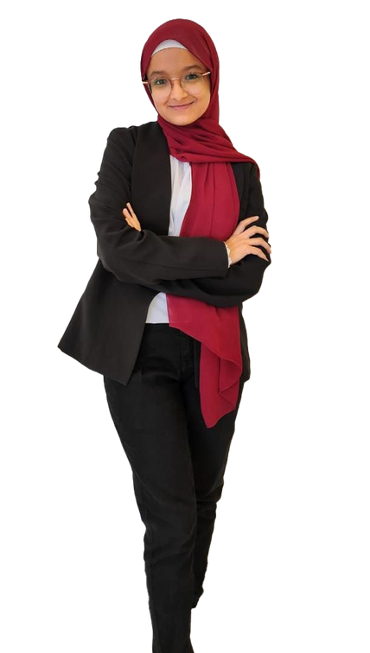


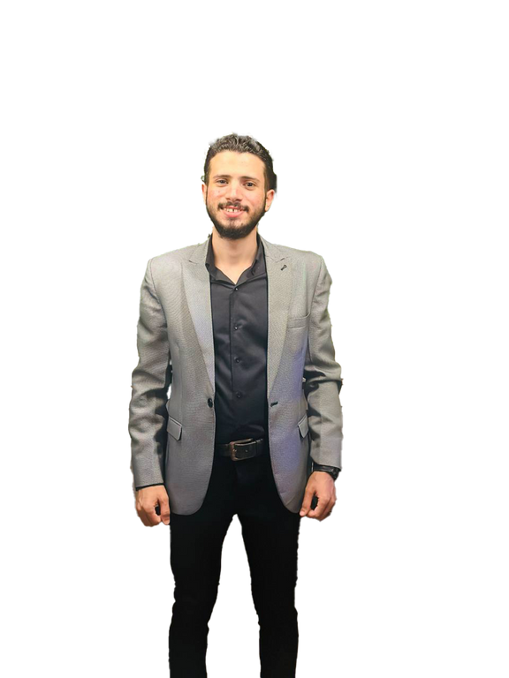


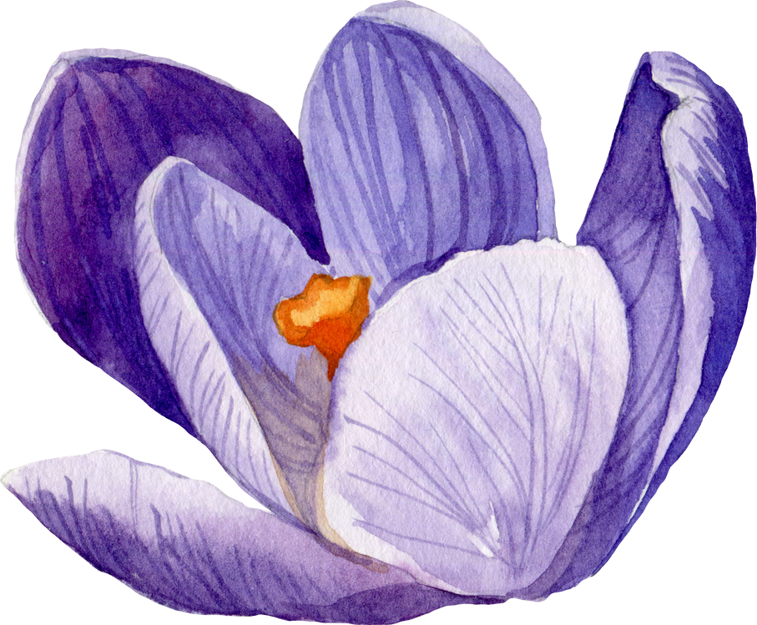

Our team :
Amr Mohamed Abdel Monam (2100493)
Menna Gamal Ali (2101078)
Renad Mohamed
AbdElhakim (2101503)
Kerolos Mokhtar Sedki (2100871)
Yassa Andria Anwer (2101690)
Samer Ayoub Fayez (2101560)
Mahmood Abdellah Fawzy (2100938)

Slide 3

Out line
1
Introdaction
9
System user
2
problem
statment
Front-End
10
3
Solutions
Back-End
11
4
Related Work
AI
12
Functional Requirements
5
Technology
13
14
Non-Functiona Requirements
Task
6
15
Demo
7
Goals
16
Time line
8
Diagrames
Future work
17

Slide 4

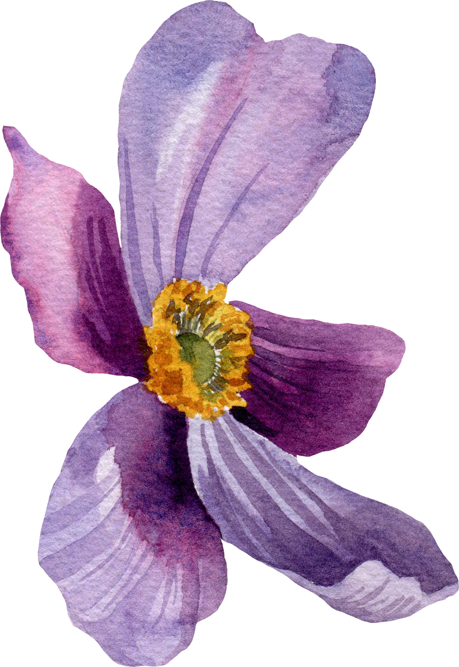
01-Introduction

Slide 5

01- INTRODUCTION
Flowers have always held a special place in human culture, symbolizing beauty, emotions, and nature. However, taking care of flowers, identifying their types, and understanding their growth requirements can be challenging, especially for beginners. With the growing interest in gardening and the increasing demand for personalized flower arrangements, there is a need for a platform that caters to both flower enthusiasts and beginners, providing them with the necessary knowledge and tools.

Slide 6
01-INTRODUCTION CONT.
This project introduces an e-commerce platform specifically designed for flower lovers. The platform serves a dual purpose: it offers detailed information on various types of flowers and plants,flowers . The integration of an AI-based tool enables users to easily identify flowers by uploading images, making the platform highly interactive and user-friendly.

Slide 7

02- Problems Statment :

Slide 8

02- Problem Statment :
01-Difficulty in identifying flower species
02-
Lack of useful and diverse flower care information
Flower enthusiasts, especially beginners, struggle to identify different flower species accurately.
Most online flower-selling platforms do not provide useful and distinctive information on how to care for flowers after purchase.
03-Need for a combined educational and e-commerce platform:
There is a gap in the market for a platform that merges educational content on flower care with the convenience of online flower and gardening product purchases.

Slide 9

03-Solutions

Slide 10
01-AI-powered flower identification tool :
03- SOLUTION :
The platform integrates an AI-based tool that allows users to upload images of flowers, enabling automatic identification. This feature helps beginners easily recognize flower species without needing prior knowledge.
02-Comprehensive flower care guides:
03-All-in-one platform for education and shopping :
Each flower listed on the platform comes with detailed care instructions, covering aspects such as watering, soil requirements, sunlight needs, and ideal growing conditions. This ensures users know exactly how to care for their Flowers post-purchase.
By combining flower identification, care guides, and an online store, the platform serves as a comprehensive solution for both educational and shopping needs. This addresses the gap in the current market by providing users with both knowledge and products in one place.

Slide 11
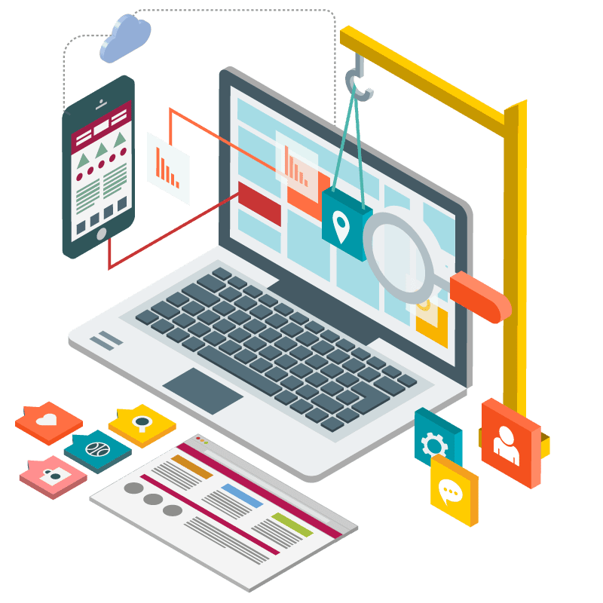
04-RELATED WORK​

Slide 12
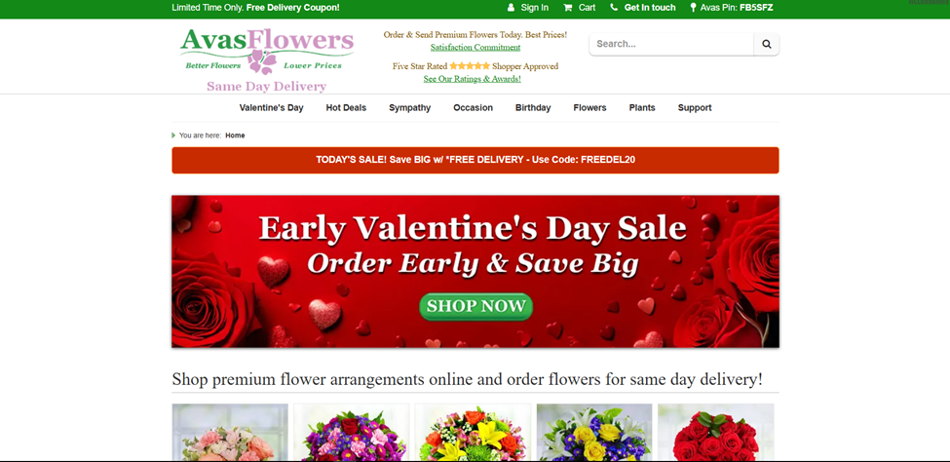
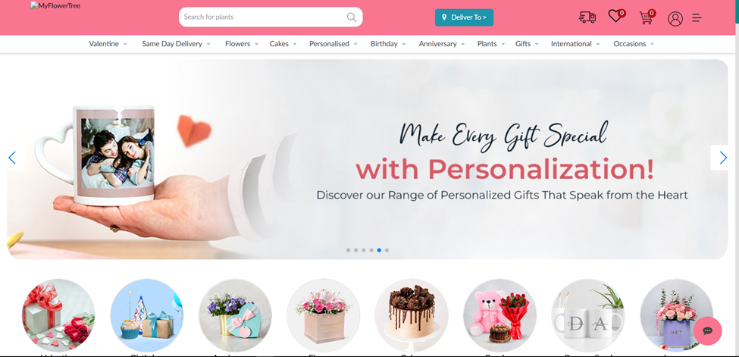
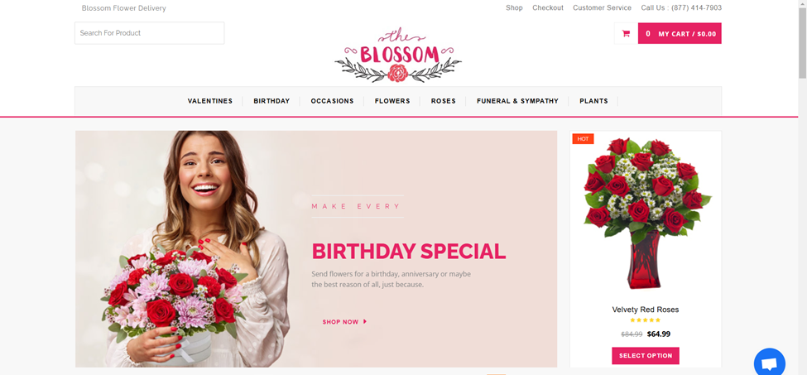
RELATED WORK​
Avas flowers
My flower tree
Blossom flower

Slide 13

DrawBacks :
Lower quality images that don't fully capture details​
Limited or no guidance on flower care
Website Usability: Users have reported challenges navigating the website, indicating that it is not user-friendly and complicates the ordering process

Slide 14

What Makes Us Unique ?

Slide 15
🌿 Guided Flower Care:
🤖 AI-Powered Flower Identification :
🌸 High-Quality Visuals :
Each delivery includes expert care instructions to help your flowers stay fresh and vibrant longer.
Our flower arrangements look just as beautiful in real life as they do online. We ensure our images are detailed and accurate, so you can shop with confidence.
It allows you to identify the name of a rose, whether it is a picture of it from the Internet or a picture in nature, and you upload it to the site.

Slide 16
05-Functional Requirements :

Slide 17
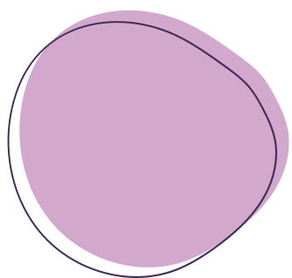

05-Functionality Requirements :
1- User Registration and Login:
Users can create an account, log in, and manage their profiles.
2- AI Flower Identification Tool :
Users can upload a picture of a flower, and the system will identify it using AI.

Slide 18
05-Functionality Requirements :
3- Flower Information Database:
A comprehensive database of flowers that includes details on care, soil, water, and light requirements.
4- E-commerce Platform :
Users can browse and purchase flowers and bouquets, with the option to add items to a shopping cart and complete purchases

Slide 19
05-Functionality Requirements :
5- Admin Panel :
Admins can manage products, users, and orders .

Slide 20
06-Non-Functional Requirements :

Slide 21



06-NON-FUNCTIONALITY REQUIREMENTS :
Usability :
Scalability:
Compatibility :
The platform should be designed to allow for future expansion, such as adding new features or supporting more users.
The system should be compatible with major web browsers and mobile devices.
The platform should be easy to use and navigate for users of all technical backgrounds.

Slide 22
07-Goals

Slide 23



Goals :
1- Provide an Easy-to-use Flower Identification System: Help beginners and flower enthusiasts identify flowers effortlessly.
2-Create a Reliable Source for Flower Care: Provide useful information about flowers and essential flower care tips

Slide 24
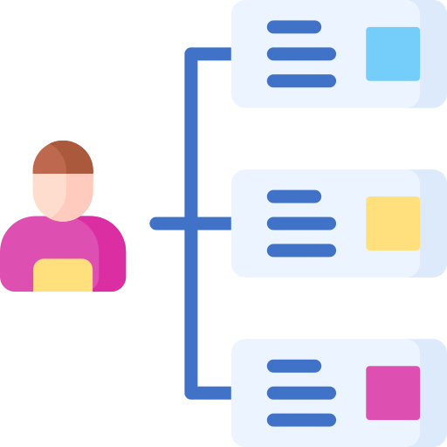
08-Diagrames (UseCase)

Slide 25
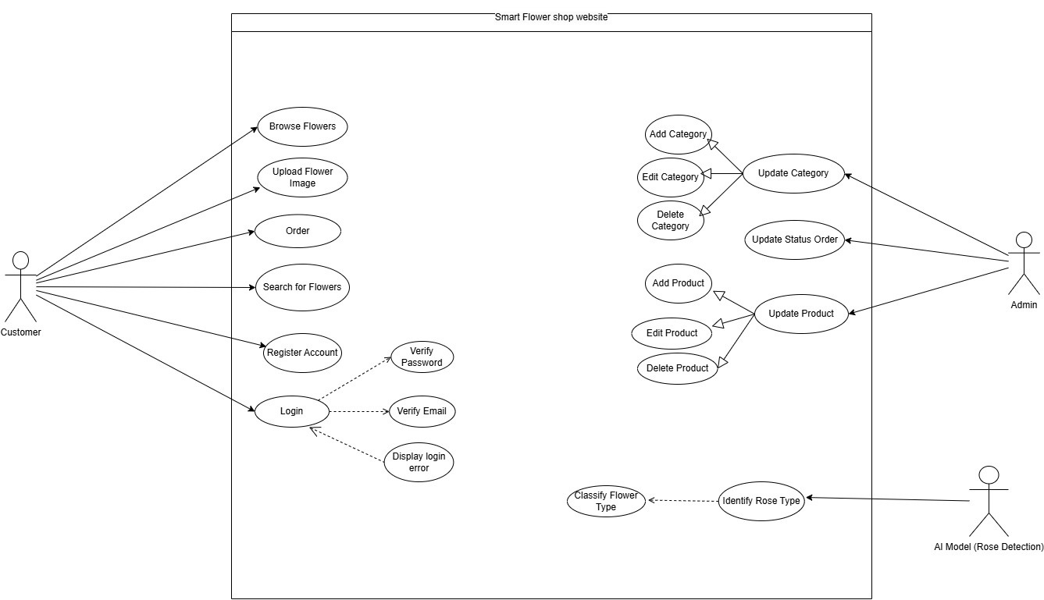
-USECASE

Slide 26
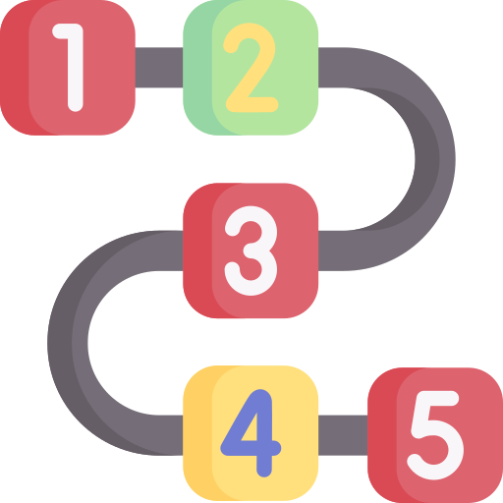
08-Diagrames (sequence)

Slide 27
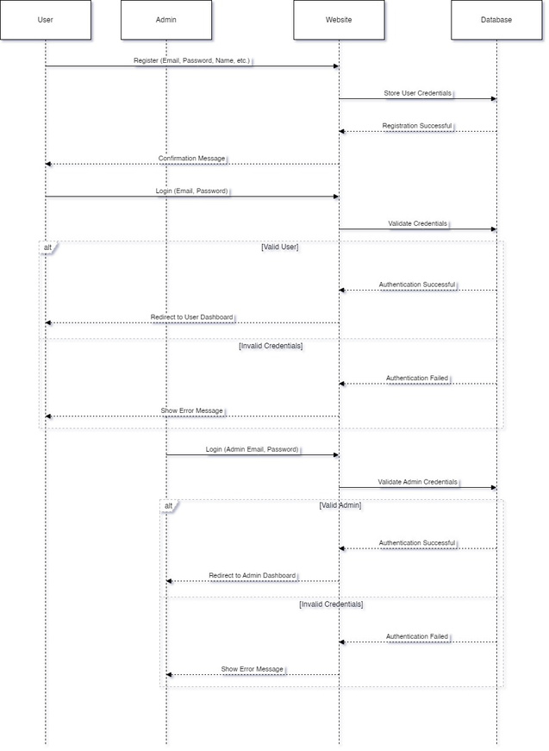
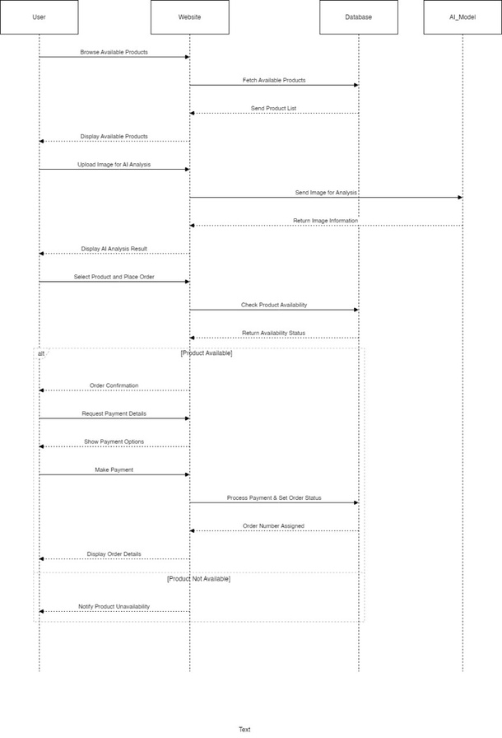
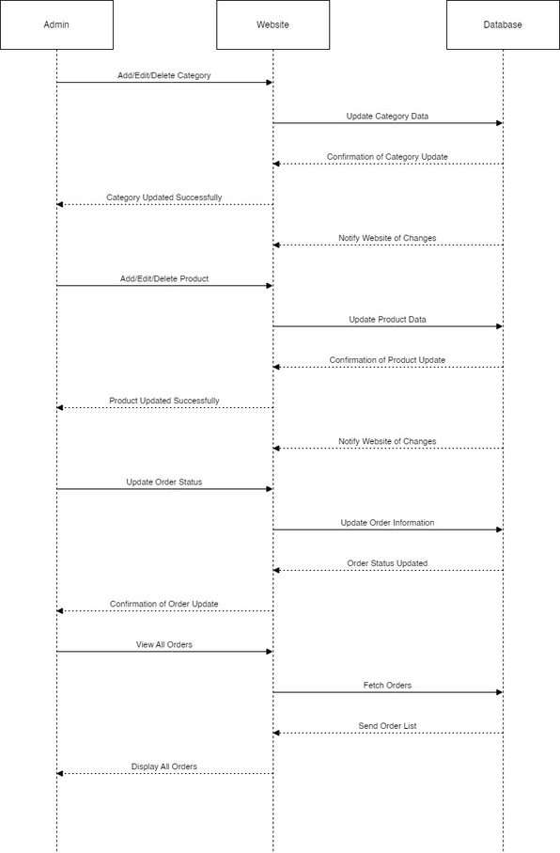
Login
User Role
Admin Role

Slide 28

09- System-User

Slide 29
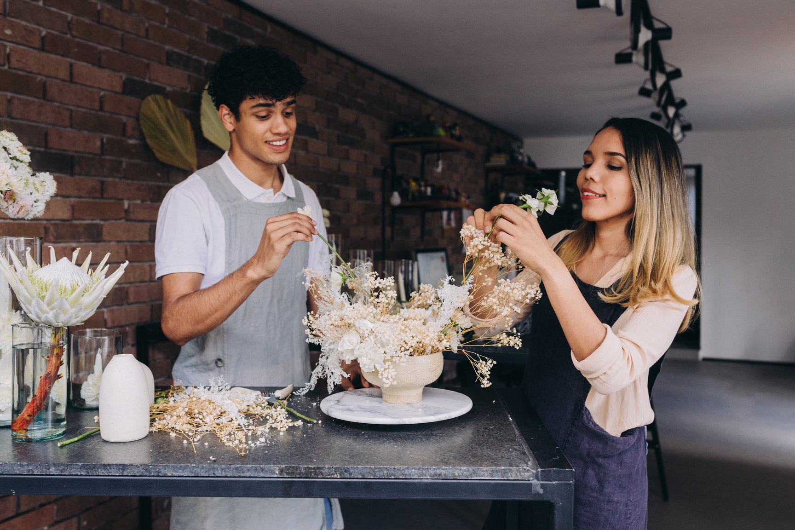
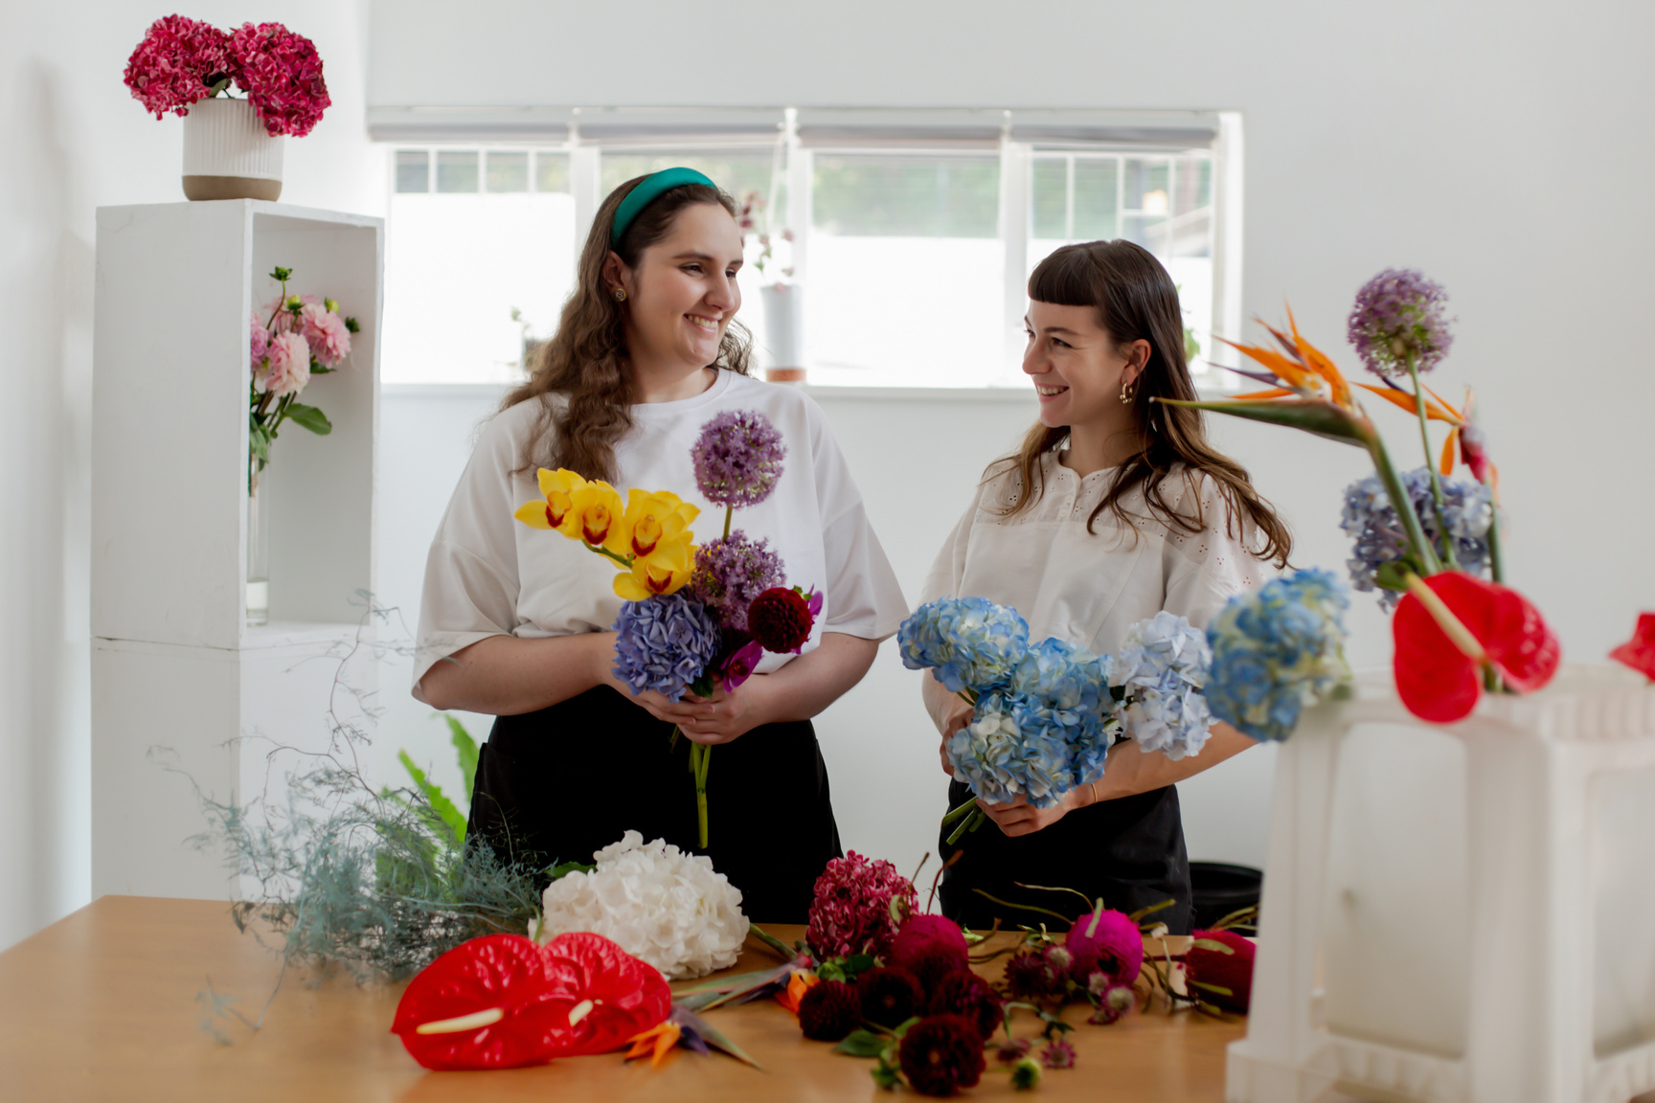
Regular Users:
Description:
Individuals who are interested in flowers and gardening, including both beginners and experienced flower enthusiasts.
09- SYSTEM-USER
Goals:
Identify different types of flowers using the AI tool.
Access detailed care guides for various flowers .
Purchase flowers through the e-commerce platform.

Slide 30


10- (Front-End)

Slide 31
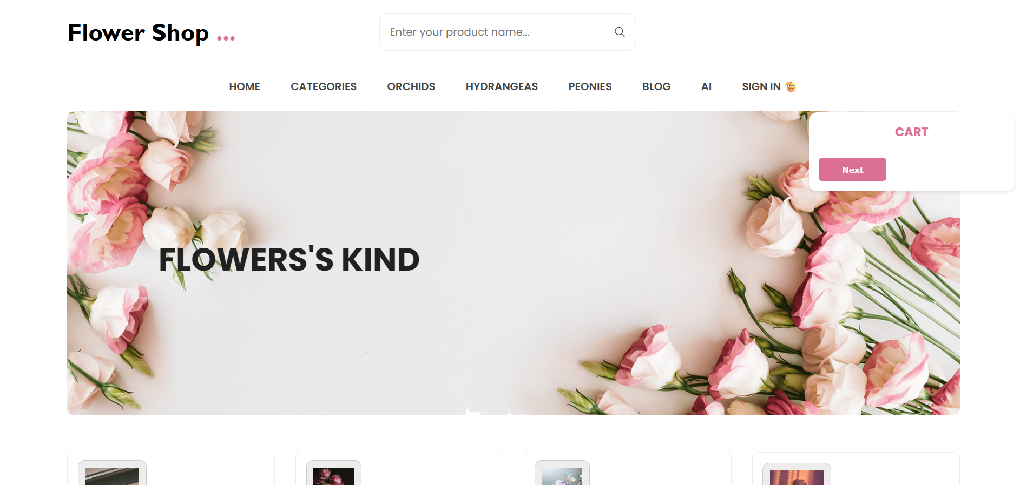
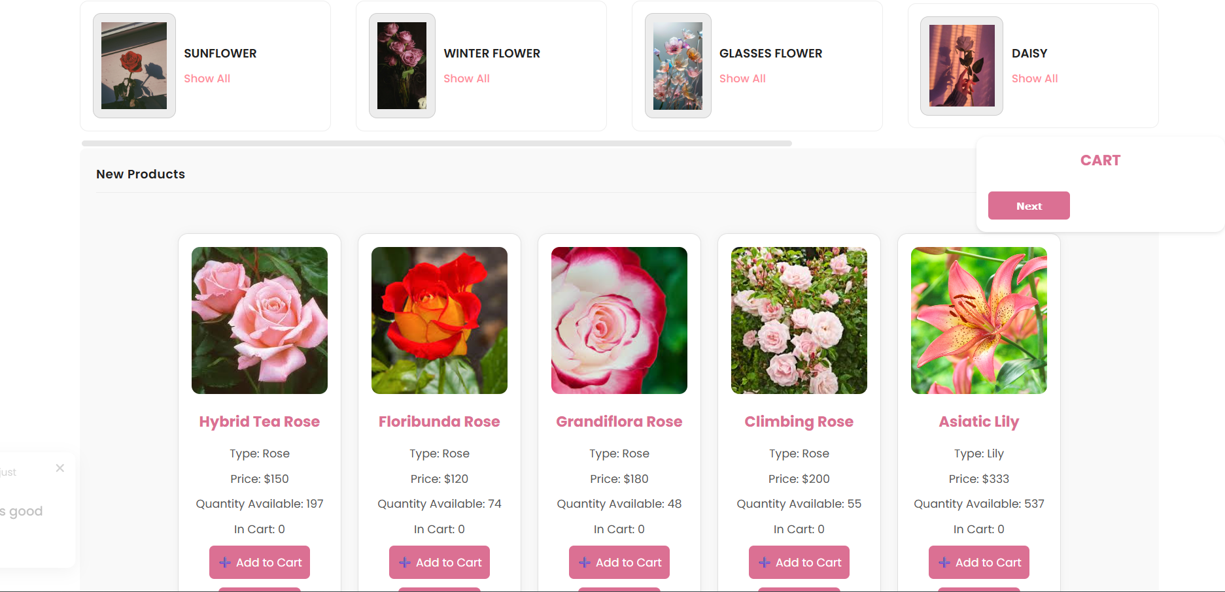
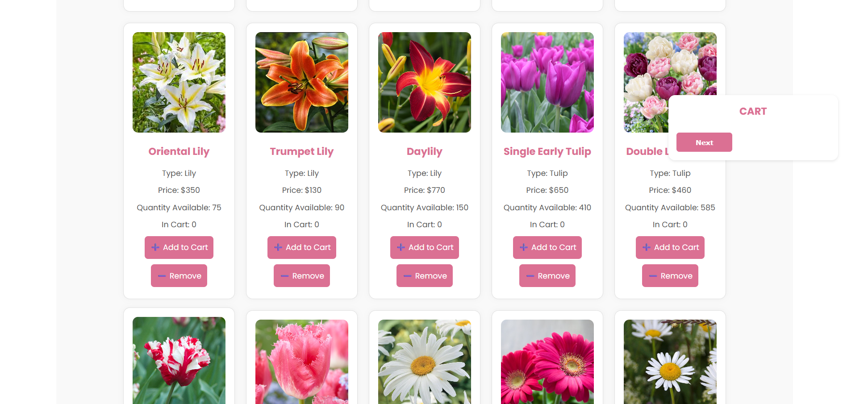
1- Home

Slide 32
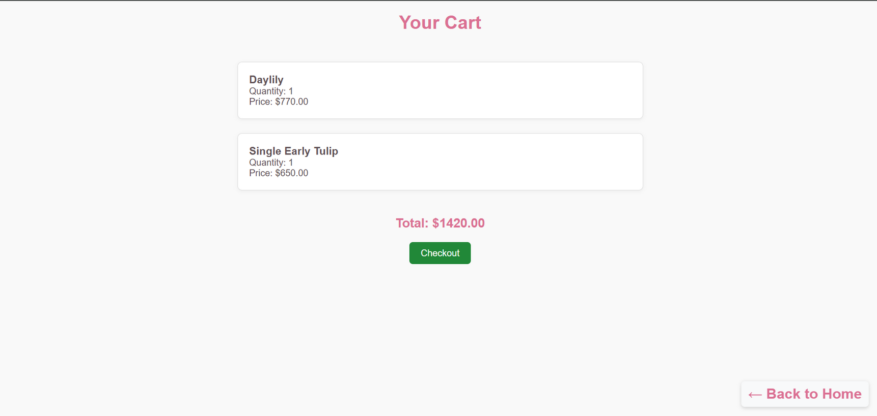
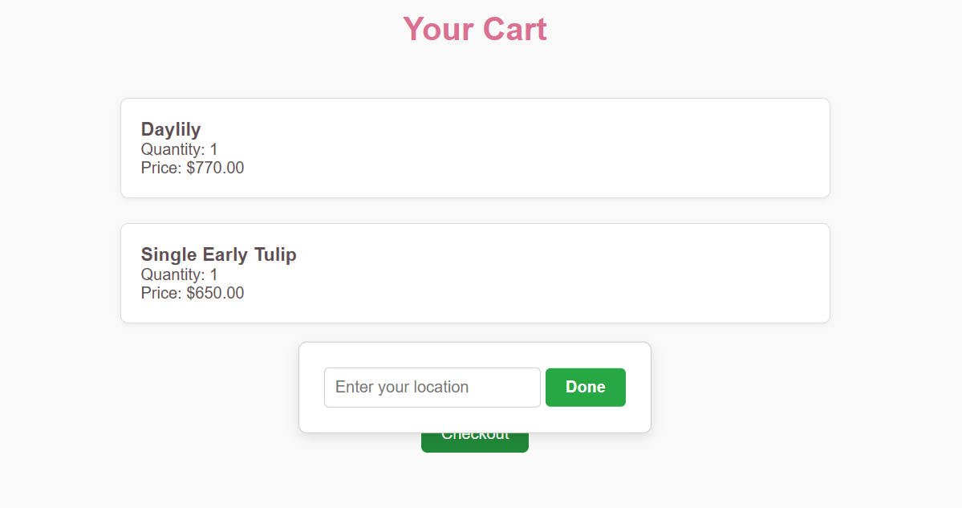
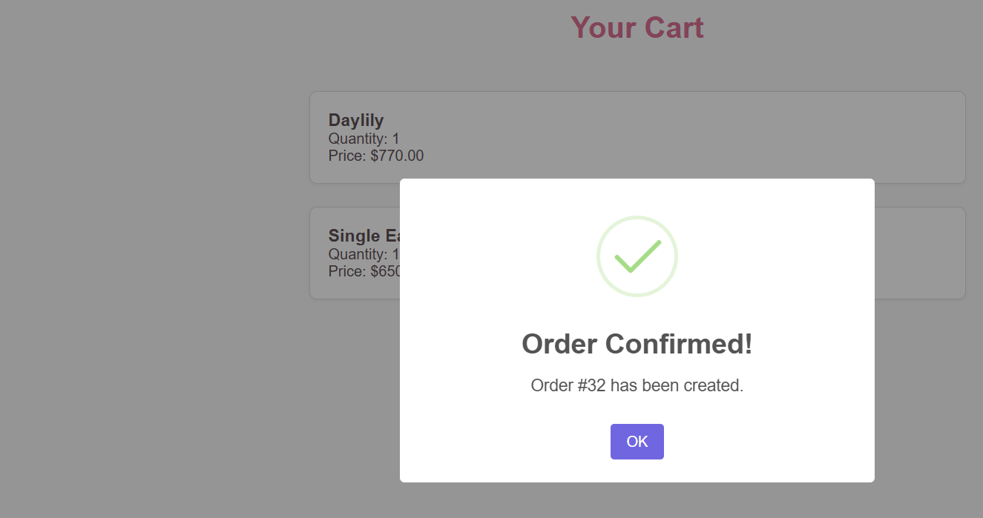
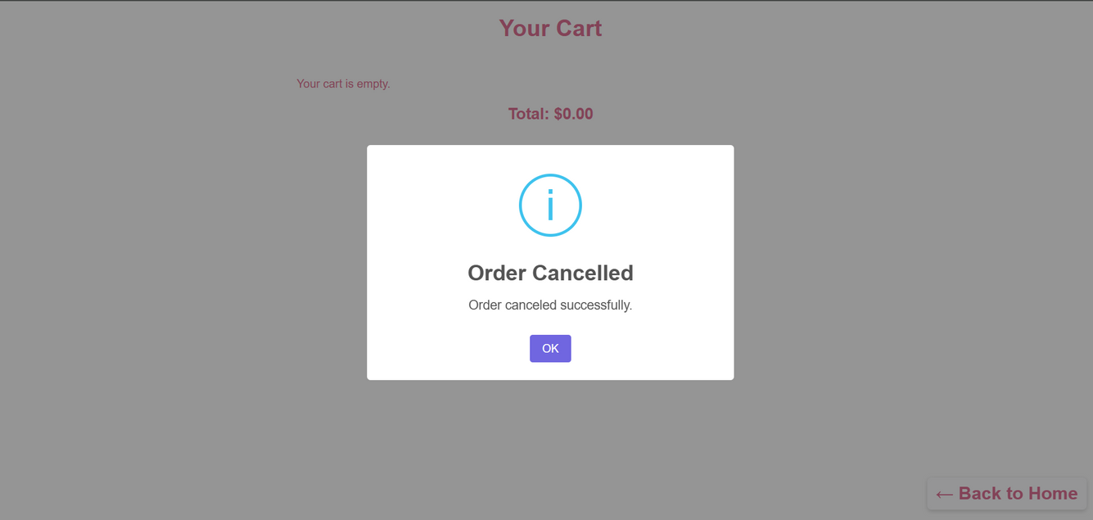

Slide 33
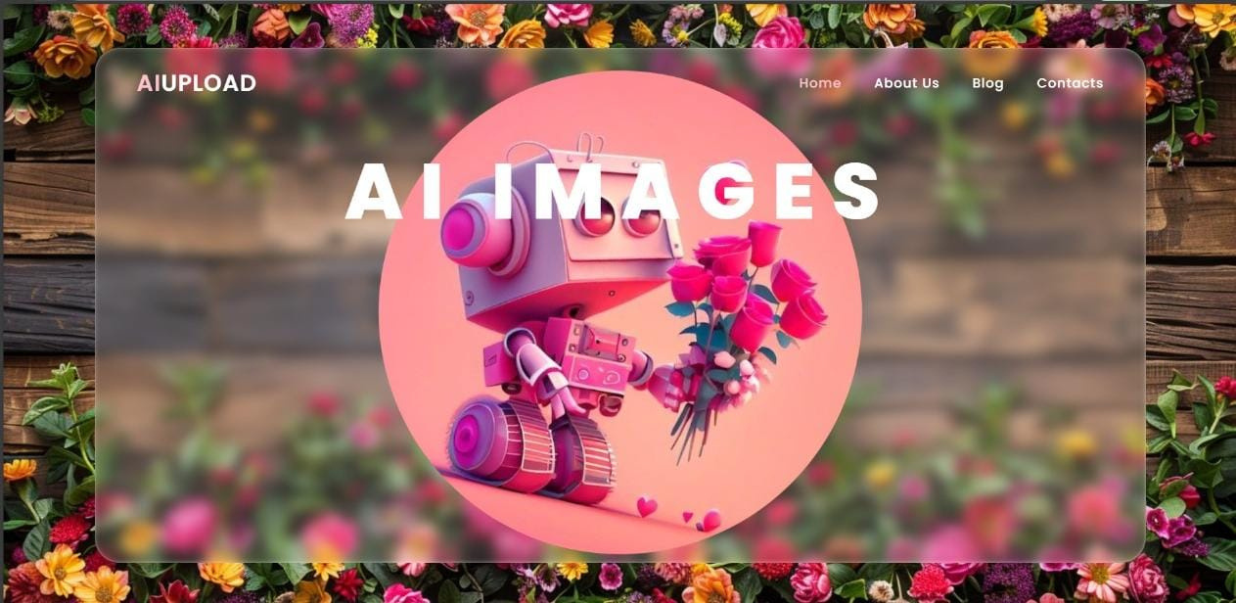
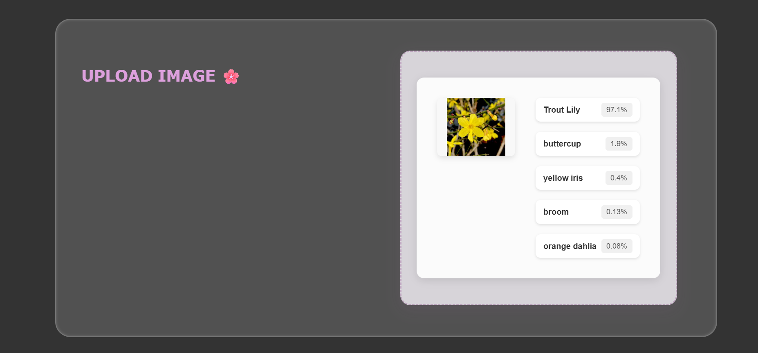
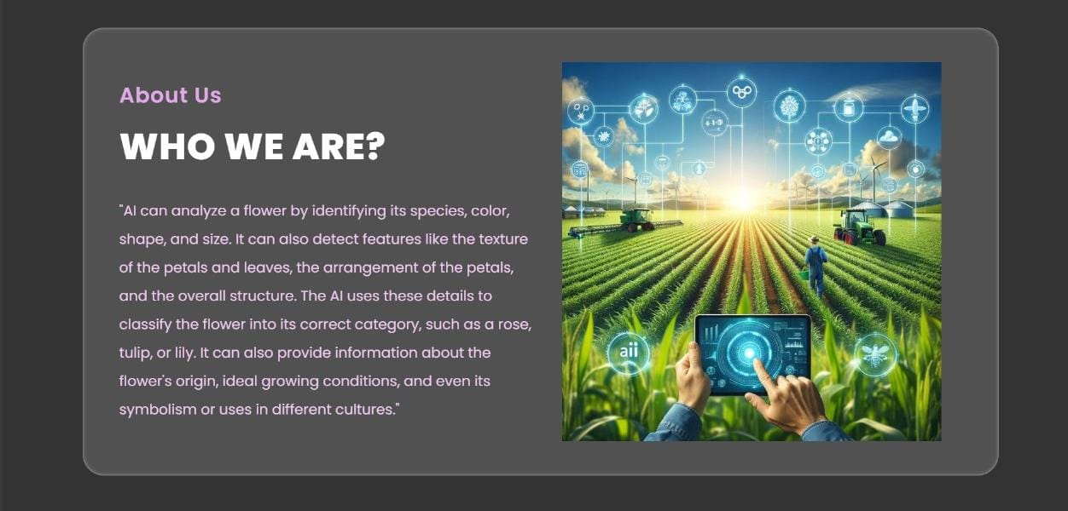
2- AI page :

Slide 34
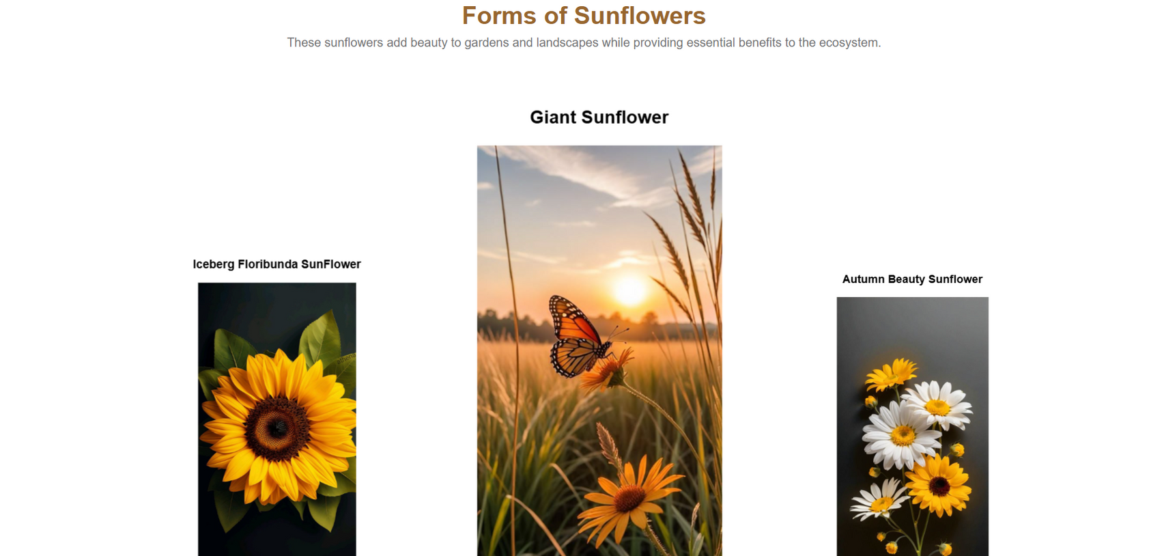
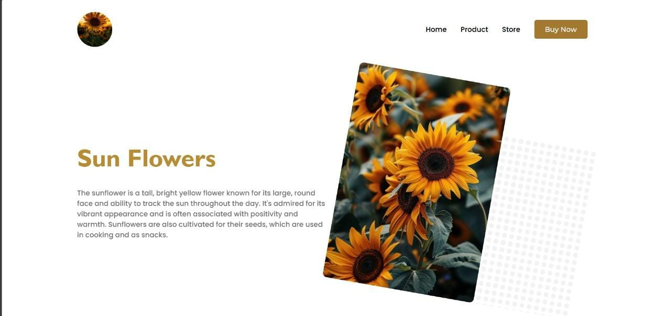
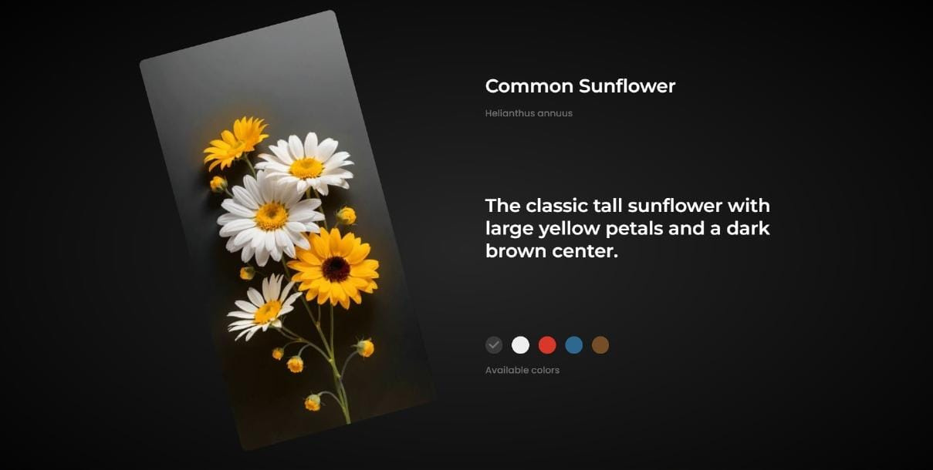
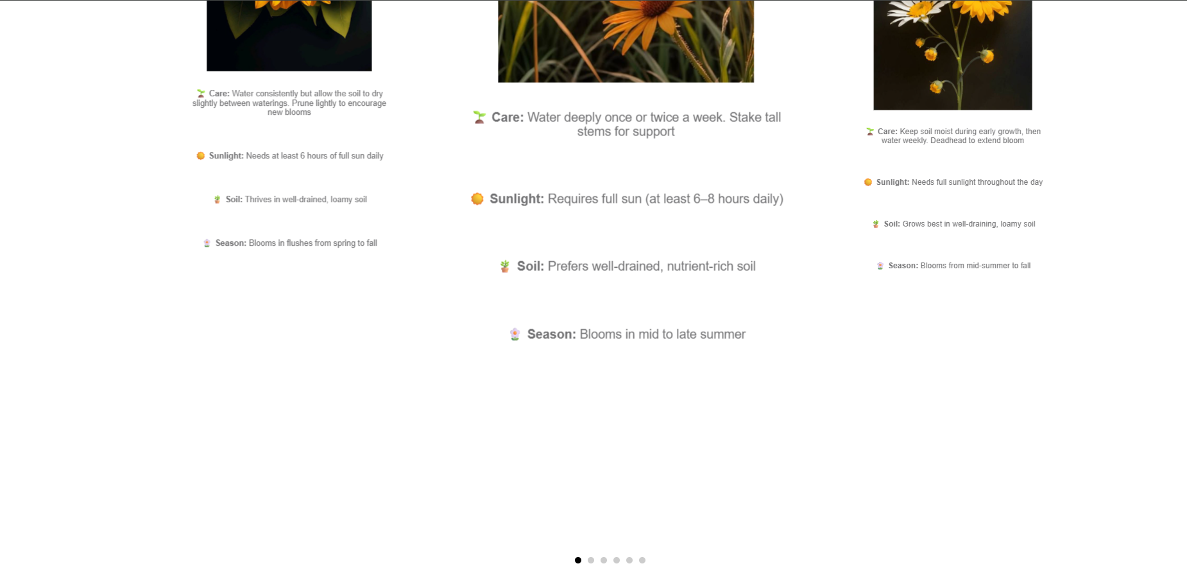
3- Care Page

Slide 35
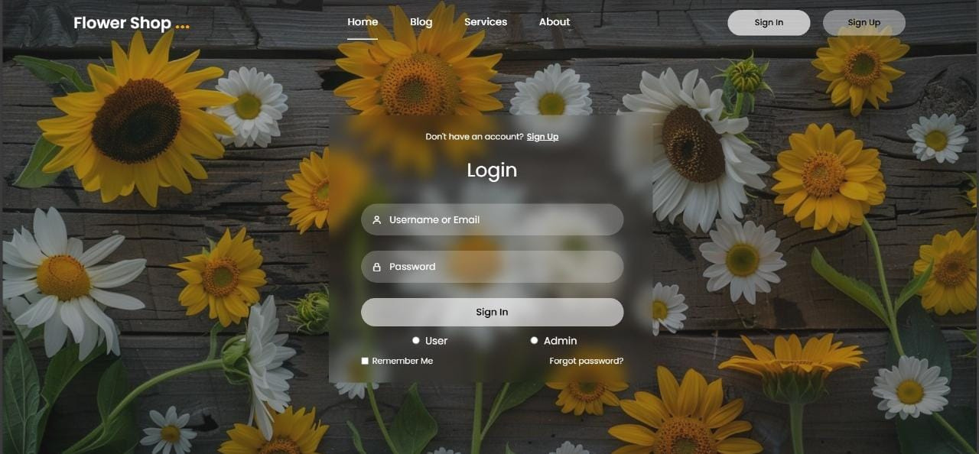
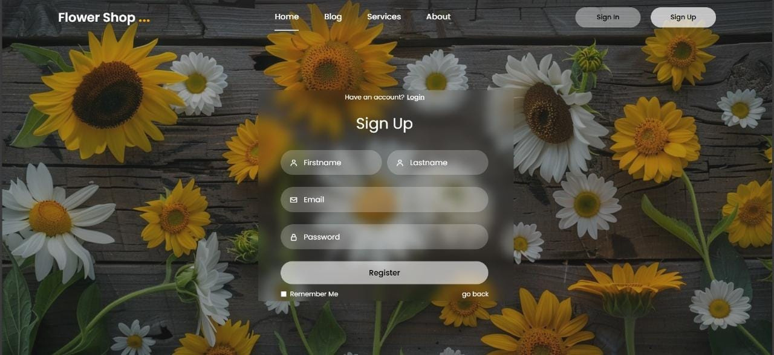
4- Sign in & Sign UP page

Slide 36
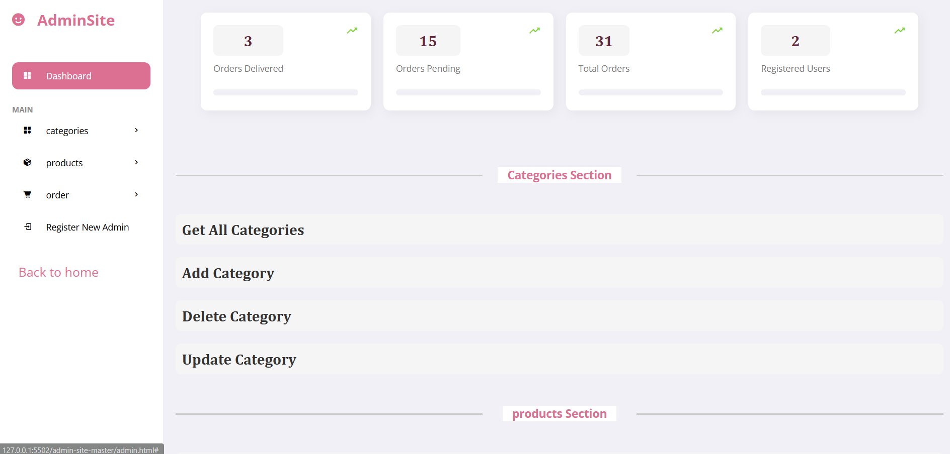
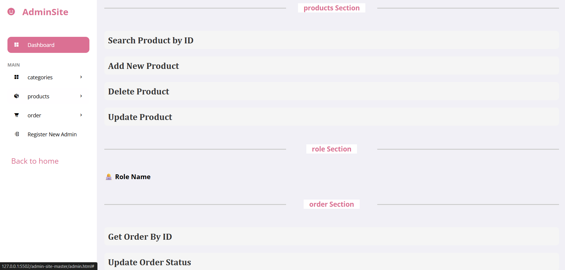
5-DashBord

Slide 37


11- (Back-End)

Slide 38
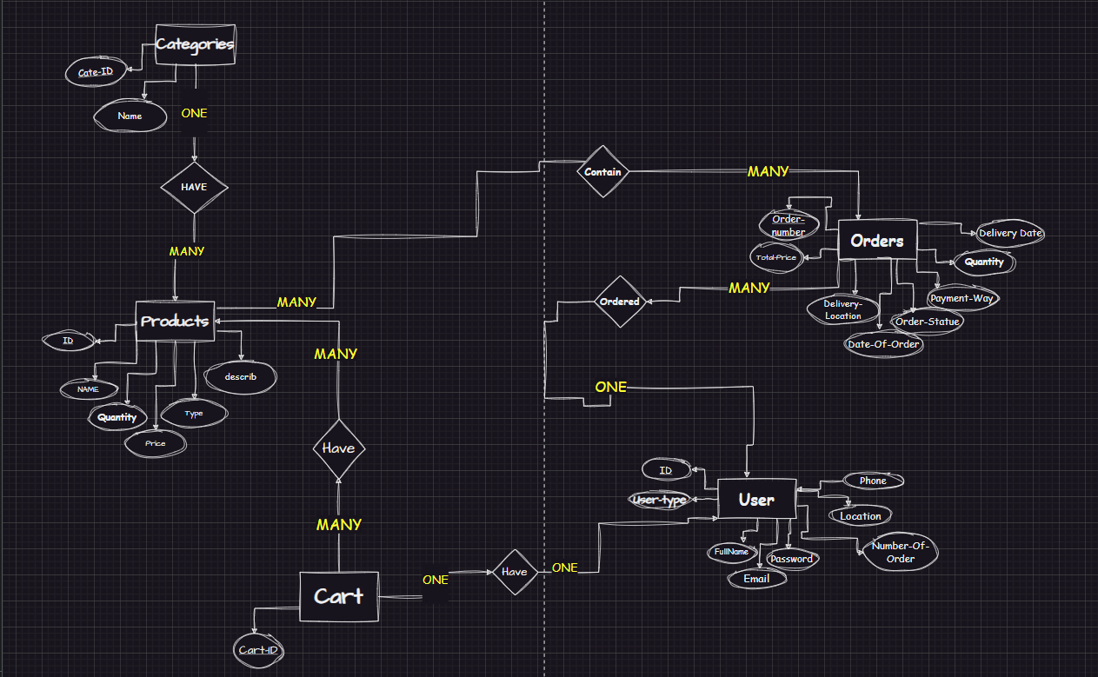
ERD

Slide 39
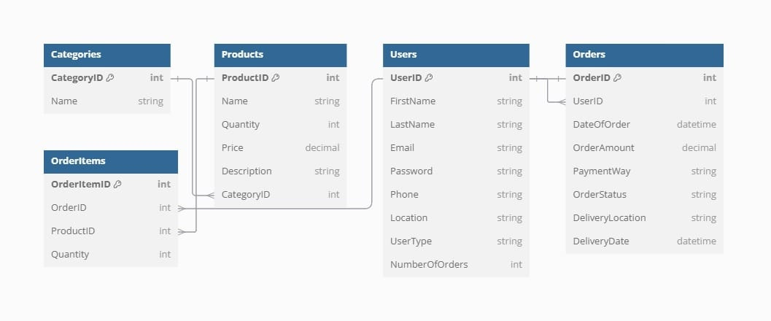
Schema

Slide 40
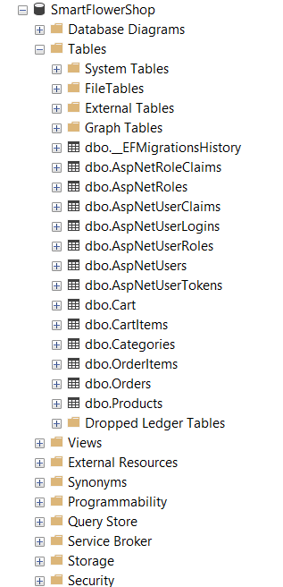
Implementation
DataBase

Slide 41
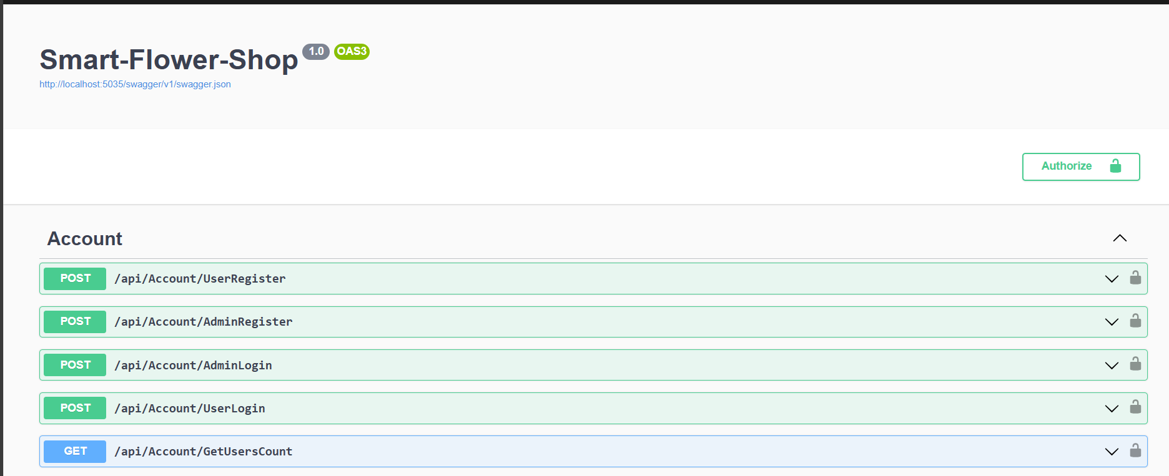
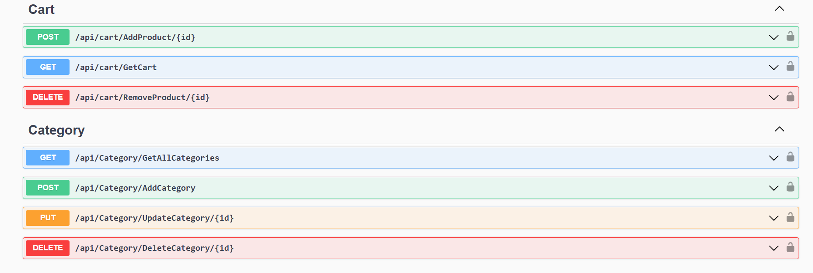
APIS-EndPoint

Slide 42
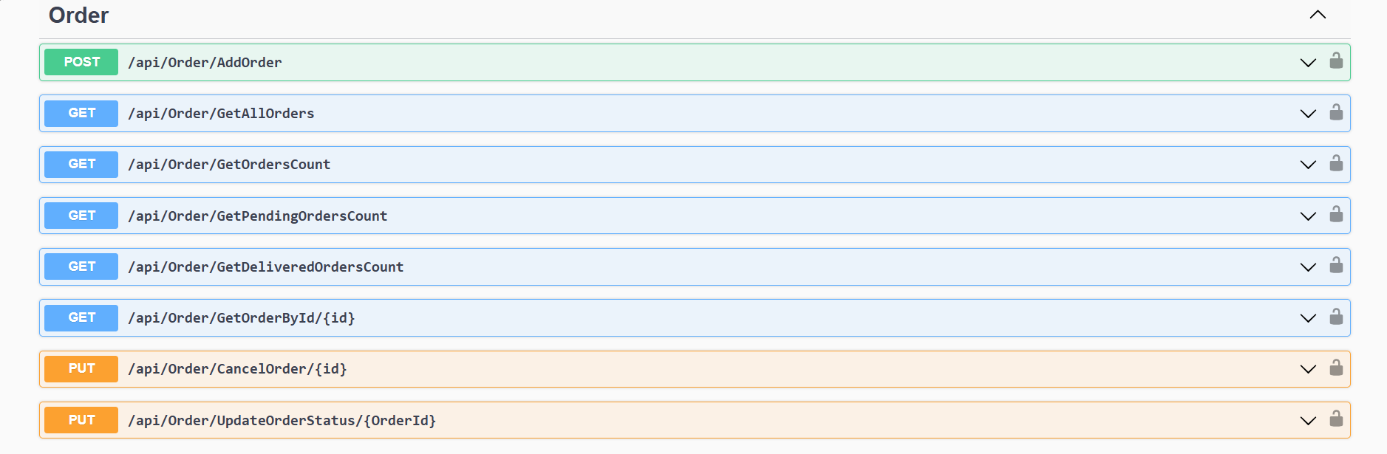
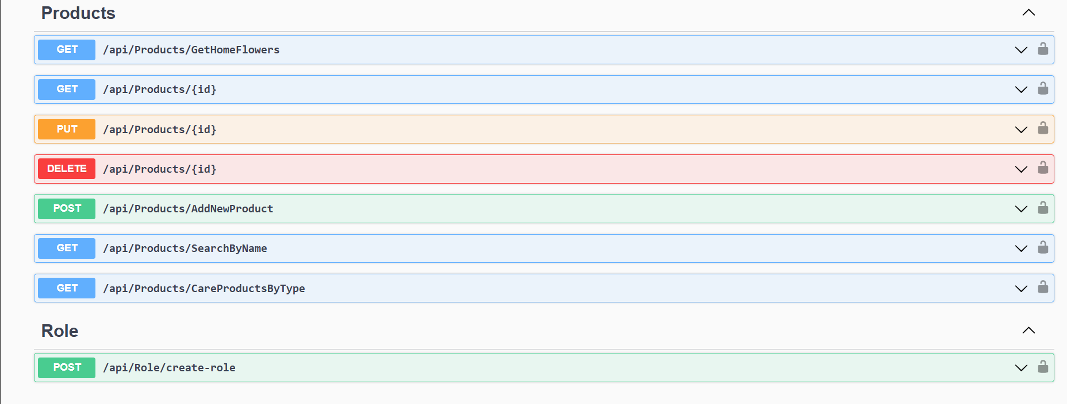
Cont.APIS-EndPoint

Slide 43
12- (AI)

Slide 44

DATASET OVERVIEW
Total Classes: 100
Training Data: 11,861 images (75%)
Validation Data: 2,349 images (15%)
Testing Data: 1,670 images (10%)
IMAGE PREPROCESSING
Resizing: Images are resized to 256×256 .
Normalization: Pixel values are scaled to the range [0, 1].
Data Augmentation :
Horizontal Flip
Brightness Adjustment
Shifting
Zooming
Note that after data augmentation, the total number of training images processed over 50 epochs is 593,050.

Slide 45
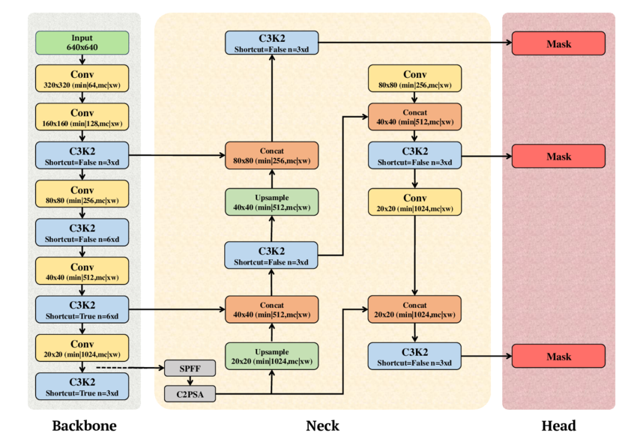
MODEL ARCHITECTURE :
Model Used: YOLOv11x, a cutting-edge, extra-large object detection model known for its high accuracy and real-time performance on complex visual tasks.
parameters: 56.9 million

Slide 46
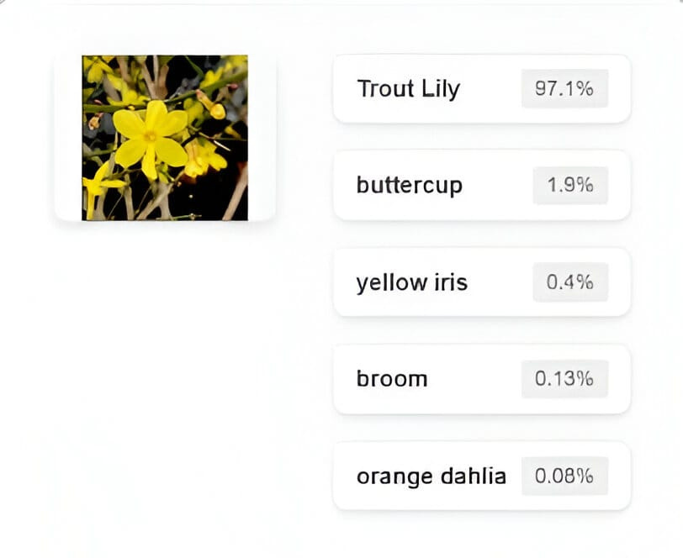
ACCURACY OF YOLOV11 :
Validation Accuracy
Top-1 Accuracy: 98.7%
Top-5 Accuracy: 99.9%
Testing Accuracy
Top-1 Accuracy: 98.3%
Top-5 Accuracy: 99.8%

Slide 47
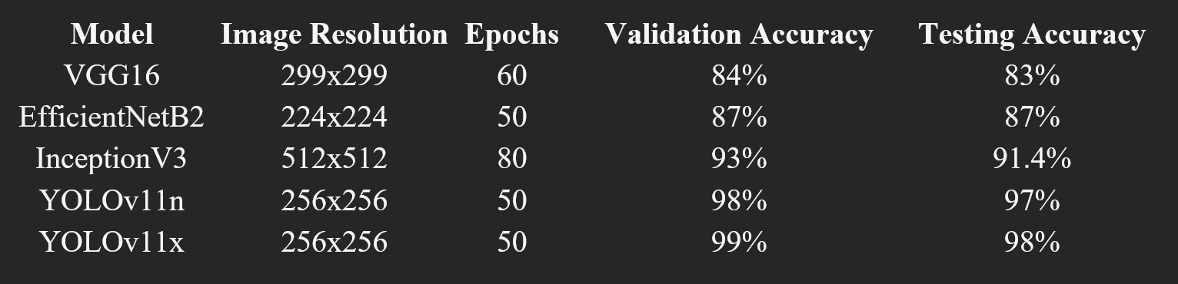
MODEL COMPARISON:
YOLOv11n is ideal for mobile apps due to its lightweight design, enabling fast, real-time inference with minimal resources.

Slide 48


13-Technology

Slide 49










Slide 50






Slide 51
14- completed TAsks

Slide 52
14- Tasks
🚀 Frontend Development
🛠️ Backend Development
•➤ complete Tasks:
•Admin Dashboard Page
•Shopping Page
•➤ complete Tasks :
• . implementation
🤖 AI Integration
•➤ Model Improvements:
•Enhancing Accuracy of Flower Classification
•Optimizing Response Time for Faster Predictions

Slide 53
15- Demo

Slide 54
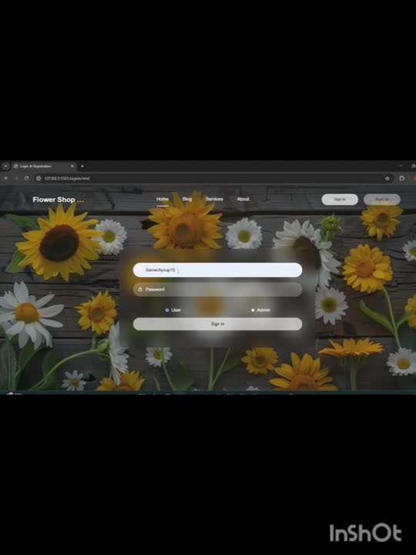

Slide 55

16-Time Plan

Slide 56

Week 5: Start the Design of UI&UX
Week 1-2: Research and understand the idea of the project
Week 3-4: Collecting the dataset
Week 9-10: Implementation front-end
Week 7-8: Implementation and build the model
Week 6: Understanding database design
Week 11: ERD & schema design
Week 12-13: Improve model accuracy
Week 14-15: Final testing and project review

Slide 57

17- Future Work

Slide 58
16. Future Work
To expand the accessibility and functionality of the platform, the following enhancements are proposed:
Mobile Application Development 📱
Currently, the platform is available as a web application. In the future, a dedicated mobile application can be developed to offer a more convenient and accessible experience for users on the go. This would also allow for better integration with device features such as camera access for flower recognition.
Plant Disease Diagnosis via Image Analysis 🌿🦠
An advanced AI-based feature can be introduced to allow users to upload images of unhealthy plants. The system would analyze the image to detect common plant diseases and provide tailored care instructions or treatment suggestions accordingly.

Slide 59


